Slide 1
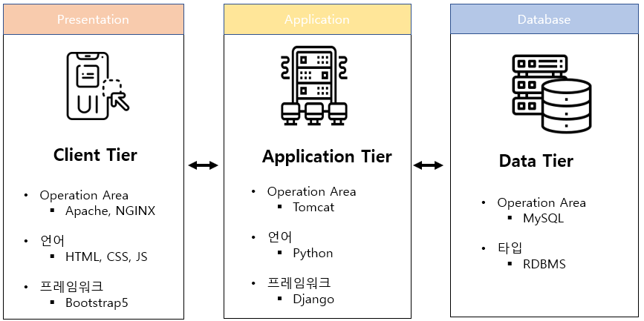
3-Tier Architecture

